Slide 1



Food and Beverage Industry Analysis
BY Pasumarthi Sri Sreshta

Slide 2
Problem Statment
The objective of this Power BI project is to analyze survey responses from the food and beverage industry to gain insights into consumer behavior, preferences, and perceptions. The analysis will help identify key trends, understand brand perception, and explore potential areas for improvement in product offerings and marketing strategies.

Slide 3
Data Tables

Slide 4
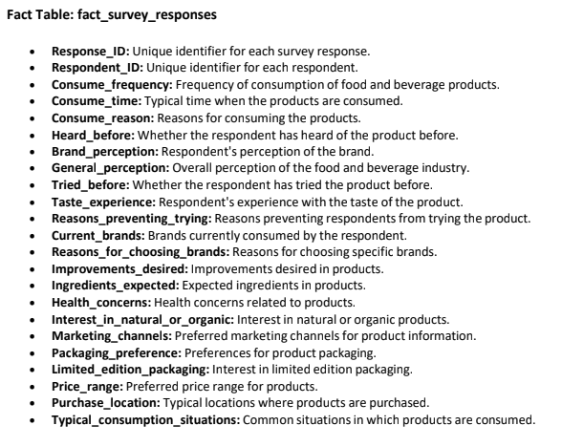
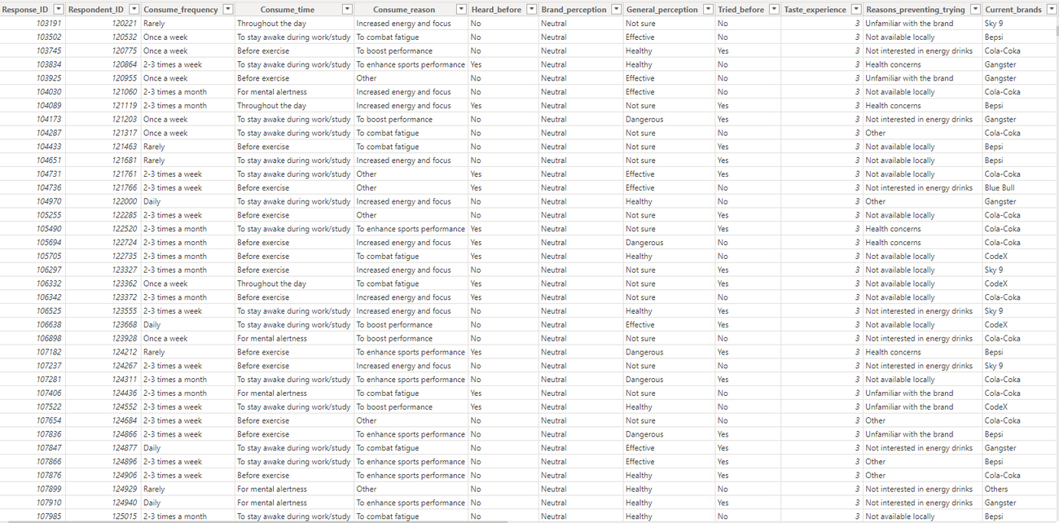
Fact Table

Slide 5
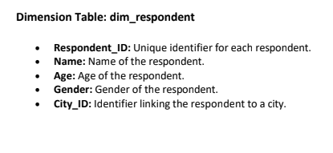
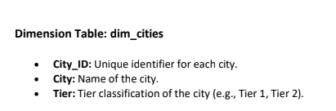
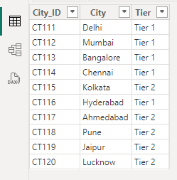
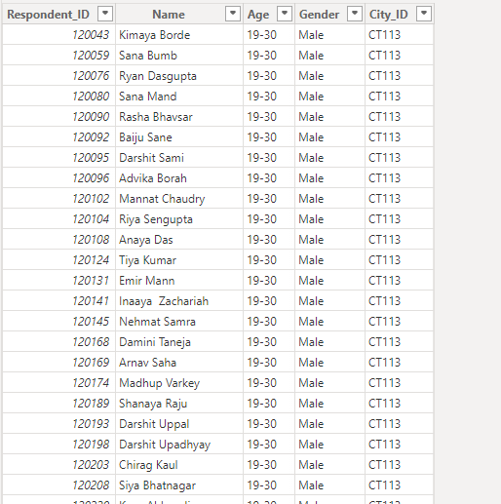
Dimension Tables

Slide 6
Transforming Data
Verified that all data types are correctly aligned with their respective columns.
Removed duplicate entries.
For the dim_cities table: Set the first row as headers.
Checked column quality and reviewed the column profile.

Slide 7
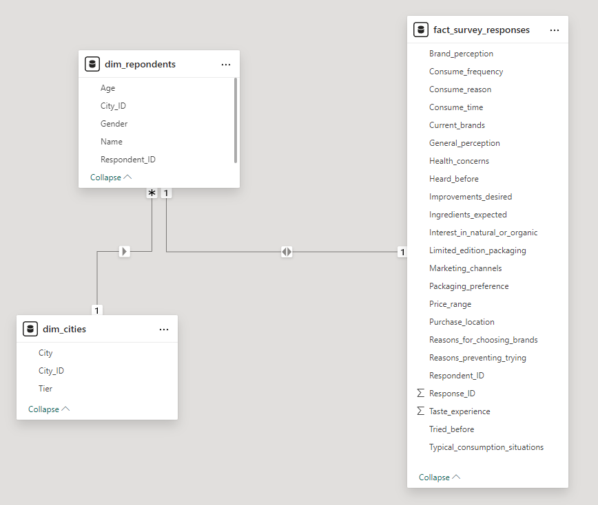
Creating Relationship between Tables

Slide 8
Data Visualization

Slide 9
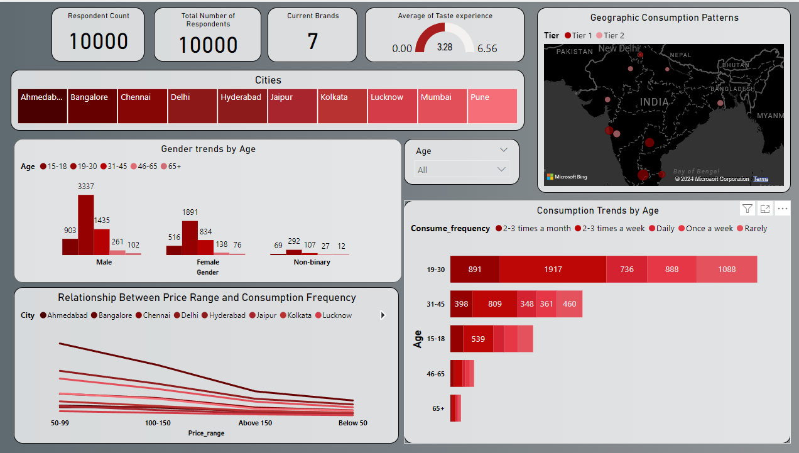

Slide 10
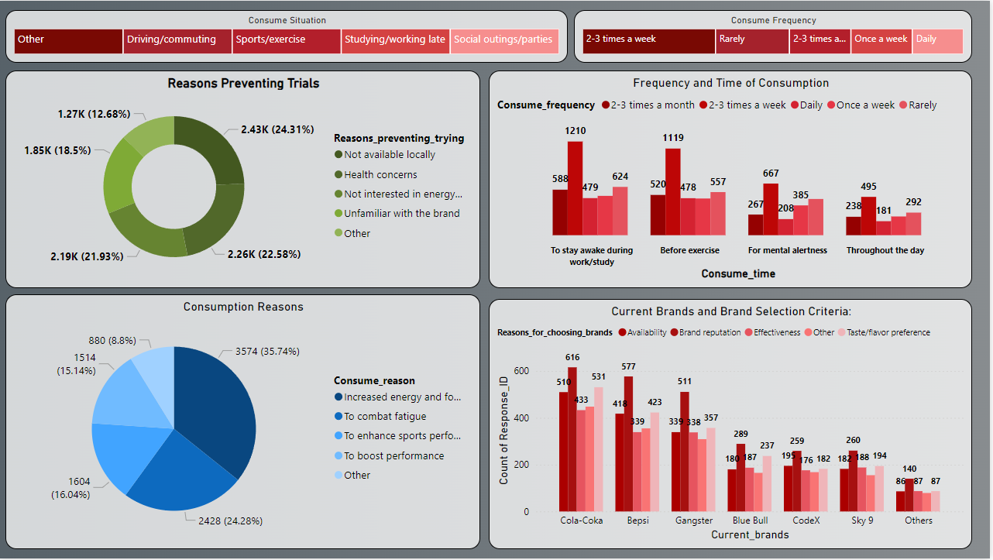

Slide 11
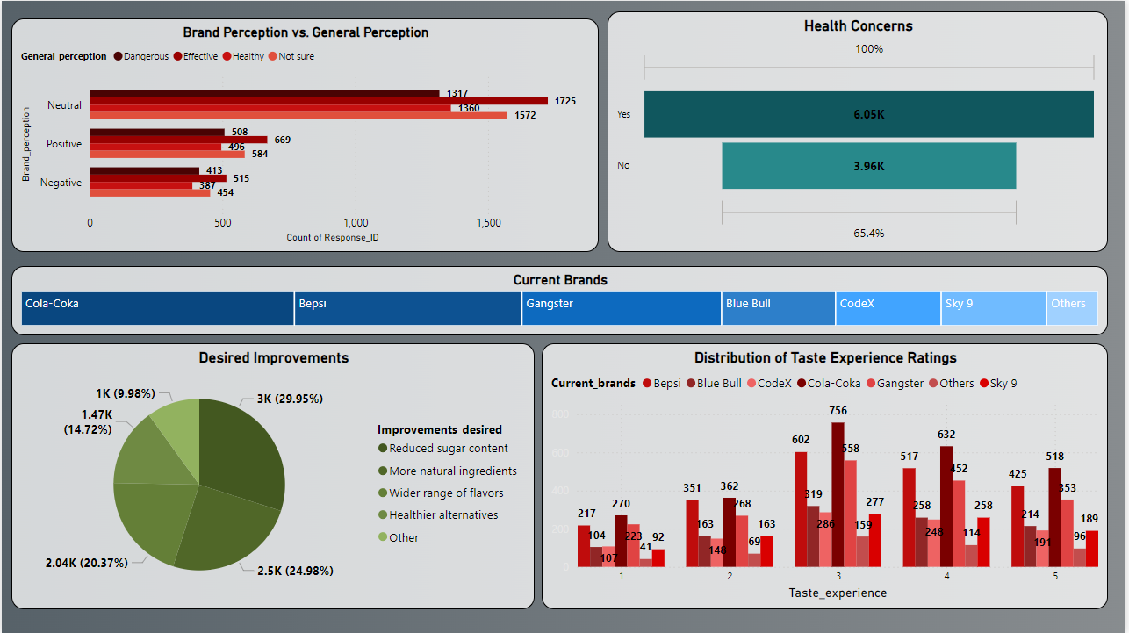

Slide 12
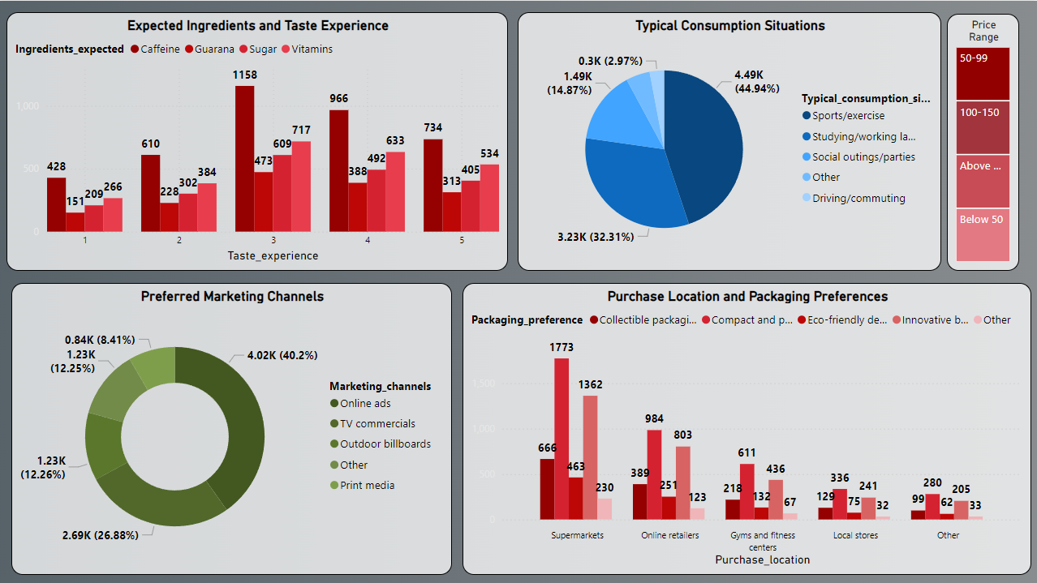

Slide 13
Insights
1. Total Number of Respondents:
- The survey gathered responses from a total of 10,000 respondents
2. Average Brand Perception:
- The average perception of the brand is Cola-Coka, indicating overall sentiment towards the brand among consumers.
3. Most Common Consumption Situation:
- The most frequent situation in which respondents consume food and beverage products is during Sports/exercise.
4. Interest in Natural or Organic Products:
- 49.83% of respondents expressed interest in purchasing natural or organic products, indicating a strong trend towards healthier options.
5. Top Reason for Choosing Brands:
- The most common reason for choosing specific brands is Brand reputation,
6. Preferred Price Range:
- The average preferred price range for food and beverage products is 50-90.
7. Packaging Preferences:
- Respondents prefer “Compact and portable cans” packaging, reflecting what consumers expect in product design.

Slide 14
Insights
8. Interest in Limited Edition Packaging:
- A significant 39.46% of respondents expressed interest in limited edition packaging.
9. Top Ingredient Expectations:
- Consumers expect caffeine in the products they purchase, which aligns with current trends in health-conscious consumption.
10. Taste Experience:
- The majority of respondents reported a “3” rating taste experience with the products they’ve tried, contributing to brand loyalty.
11. Health Concerns:
- 60.45% of respondents mentioned health concerns related to food and beverage products.
12. Marketing Channels:
- The preferred marketing channel for receiving product information is Online ads.
13. Typical Purchase Location:
- Respondents commonly purchase products from Supermarkets.
14. Frequency of Consumption Across Price Ranges:
- A trend shows that 2-3 times a week consumption frequency correlates with 50-90 price ranges, indicating price sensitivity among respondents.

Slide 15
Thank
You

